Slide 1
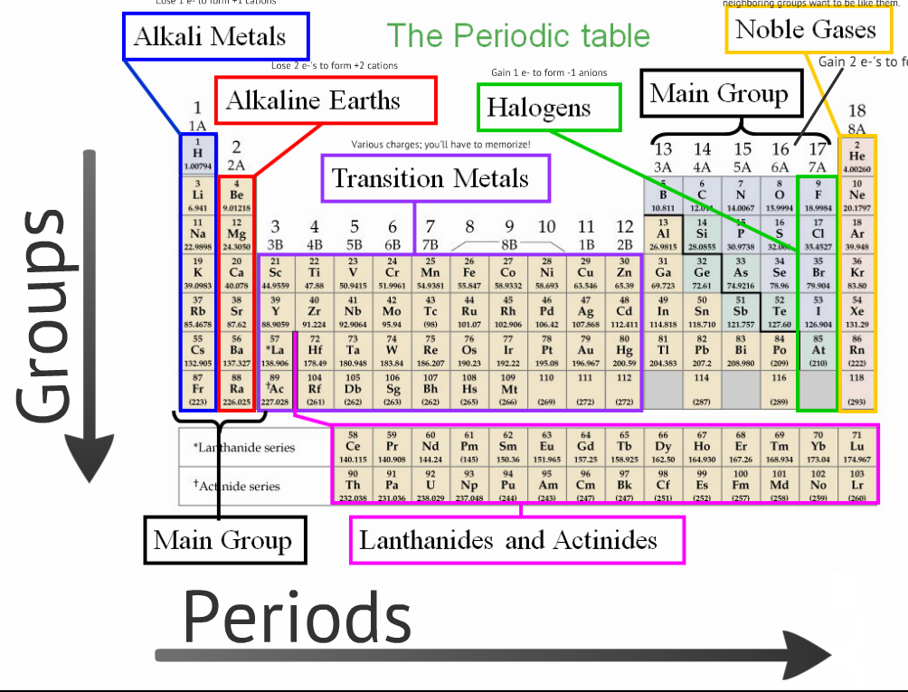

Slide 2
Non-metals
To the right of the red dividing line.
1
H
2
He
5
B
6
C
7
N
8
O
9
F
10
Ne
14
Si
15
P
16
S
17
Cl
18
Ar
32
Ge
33
As
34
Se
35
Br
36
Kr
51
Sb
52
Te
53
I
54
Xe
84
Po
85
At
86
Rn
Metals
All elements to the left of the red dividinng line. Metals comprise the vast majority of all the elements
Metalloids
Also called semi-metals, shaded in blue.

